Slide 1


SERL-PROJECT
PRESENTED BY
Naysha Singh, IIT2021140 Shruti Bilolikar, IIT2021172 Radhika Gupta, IIT2021125 Pankti Salvi, IIT2021134 Karishma Mitra, IIT2021204
GROUP-NAME - SYSCODE

Slide 2



INTRODUCTION
I
CONTENTS
T
TECH-STACK USED
F
IMPLEMENTED FEATURES
D
DIAGRAMS

Slide 3


INTRODUCTION
SERL WEBSITE IS AIMED TO PROPAGATE INFORMATION OF SOFTWARE ENGINEERING RESERACH LABORATORY. IT PROVIDES INFORMATION ABOUT FACULTIES AND
RESEARCHERS WHO ARE ACTIVELY WORKING ON PROJECTS AND PUBLICATIONS
RELATED TO SOFTWARE ENGINEERING. THE WEBSITE ALSO PROVIDES RESOURCES RELATED TO SERL FOR THOSE WHO ARE INTERESTED. ONE-CLICK FEATURE OF THE WEBSITE WILL SAVE A LOT OF TIME OF USERS WHO HAVE TO VISIT THE SERL FOR
SMALL REASONS AT TIMES.

Slide 4
Javascript
J
TECH-STACK USED
P
PHP
H
HTML5
C
CSS3

Slide 5
IMPLEMENTED FEATURES
Information of all people associated with the lab
Different types of project associated with the lab like sponsored project. Courses run by the lab page
Information of different courses as instructor,PHD TA amd M.Tech TA, course projects, number of students, then no of it student, mba student, and publications of lab in current format.
Dynamically add data from frontend as well as backend and it should reflect in database.
Admin should get appropriate options to operate the website after login for eg. add publication/remove publication etc
Proper display of publications/researches/up-coming events on homepage, i proper section of the website.

Slide 6
IMPLEMENTED FEATURES
In showing publications the publication should be shown in every authors profile page. The profile page must be created for every user that has signed up on the website.
For each user/ta show every information like all publication he has published/all subjects he has taken as being a TA etc.
Each project group should display the publication in MLA format along with all the information required from the MLA format.

Slide 7

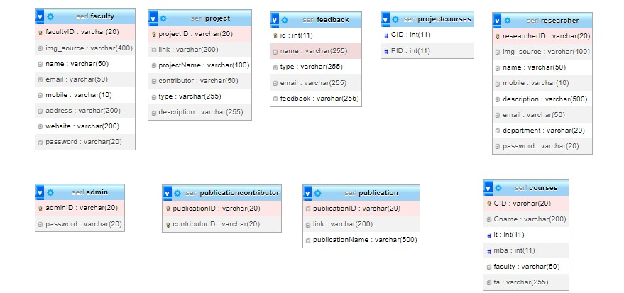

SCHEMA-DIAGRAM

Slide 8
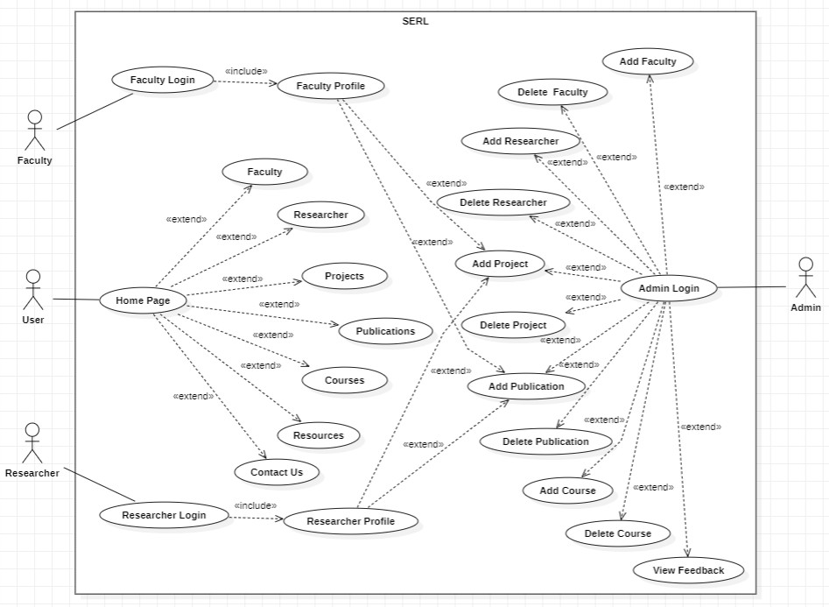
USE CASE

Slide 9

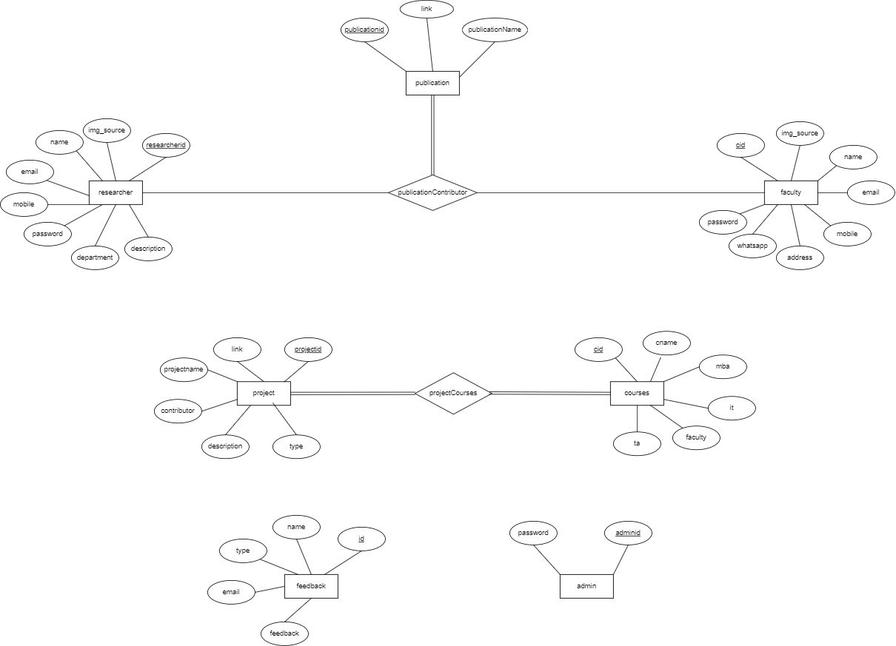
ER DIAGRAM

Slide 10



Slide 11

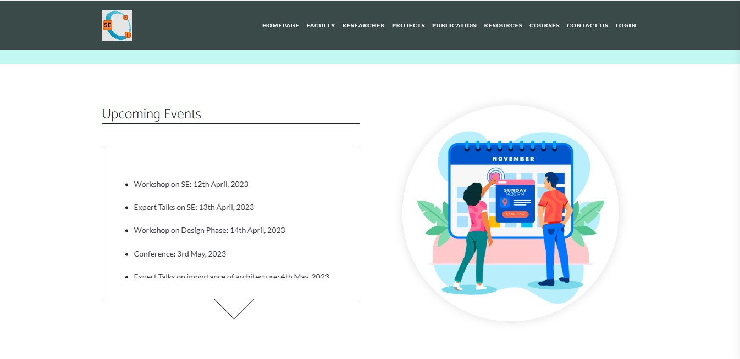

Slide 12
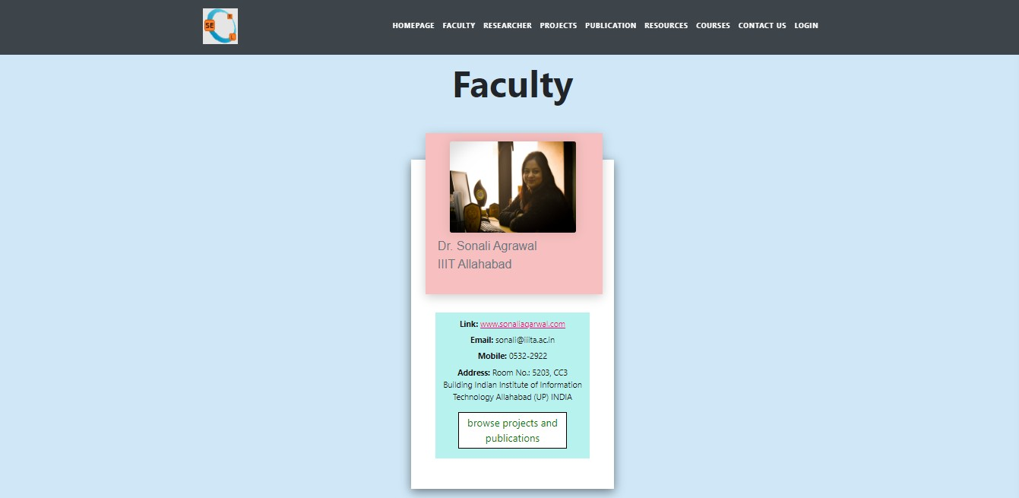

Slide 13
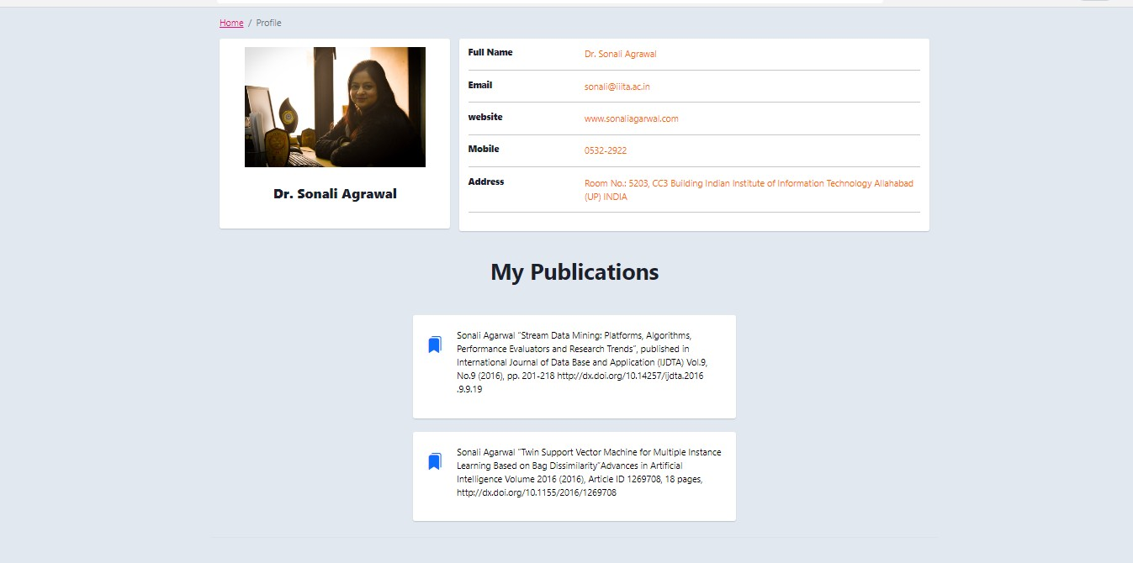

Slide 14
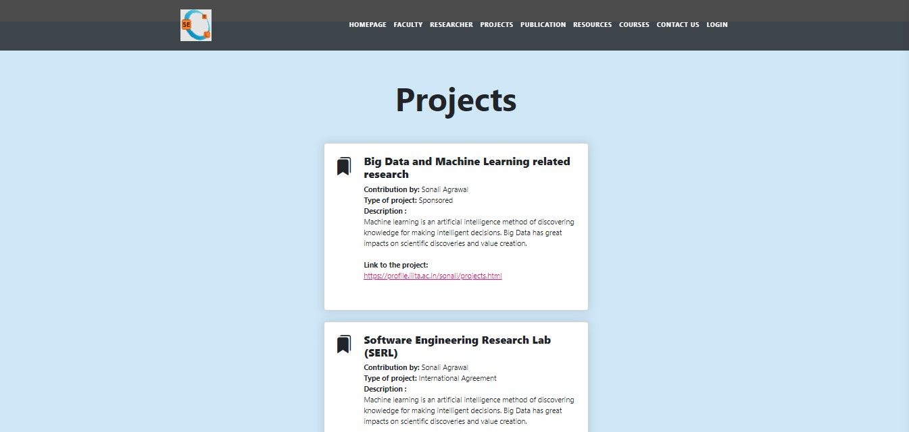

Slide 15
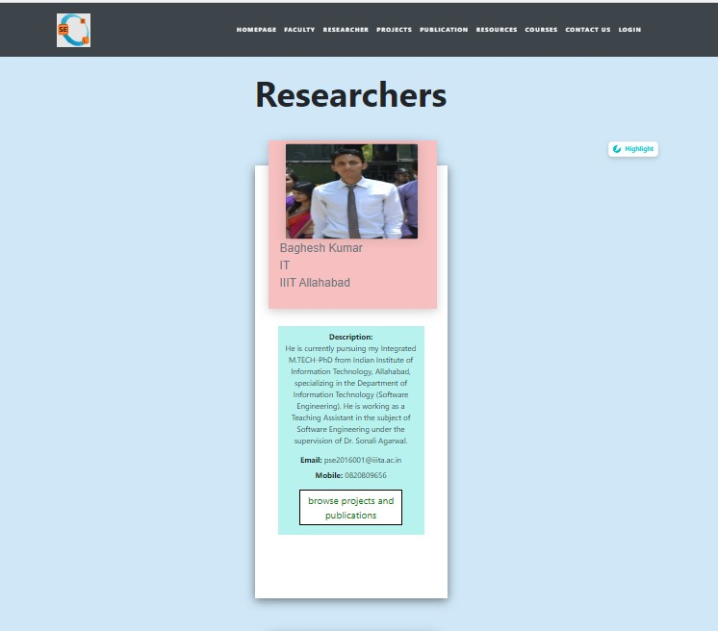

Slide 16
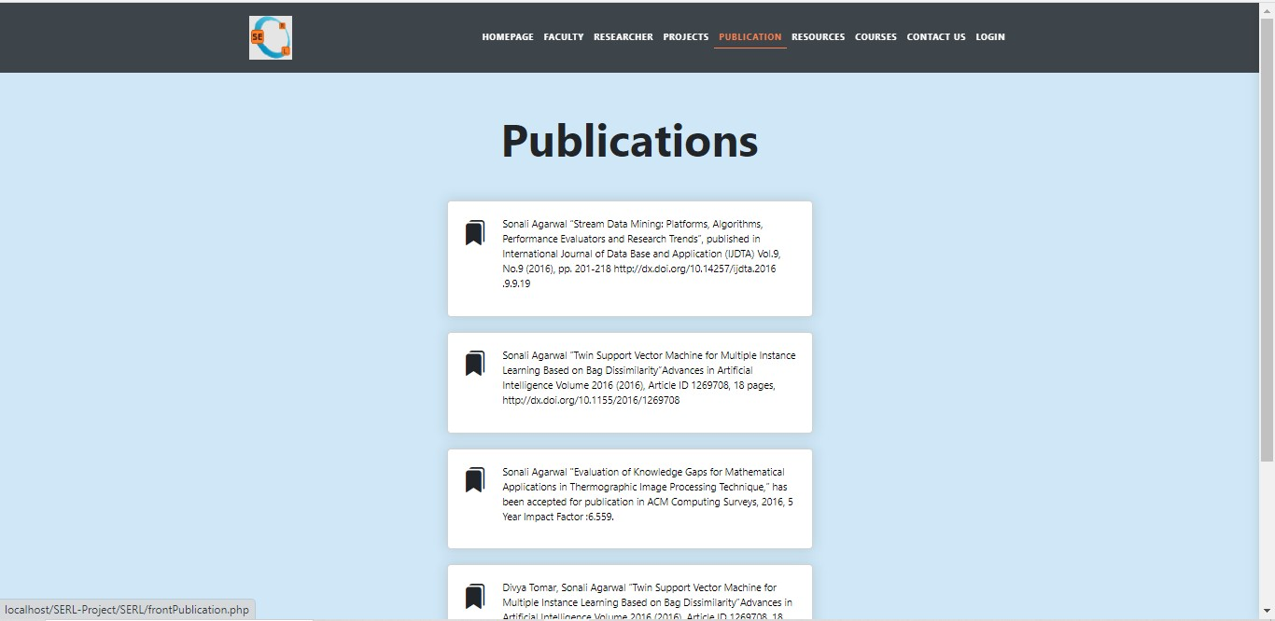

Slide 17
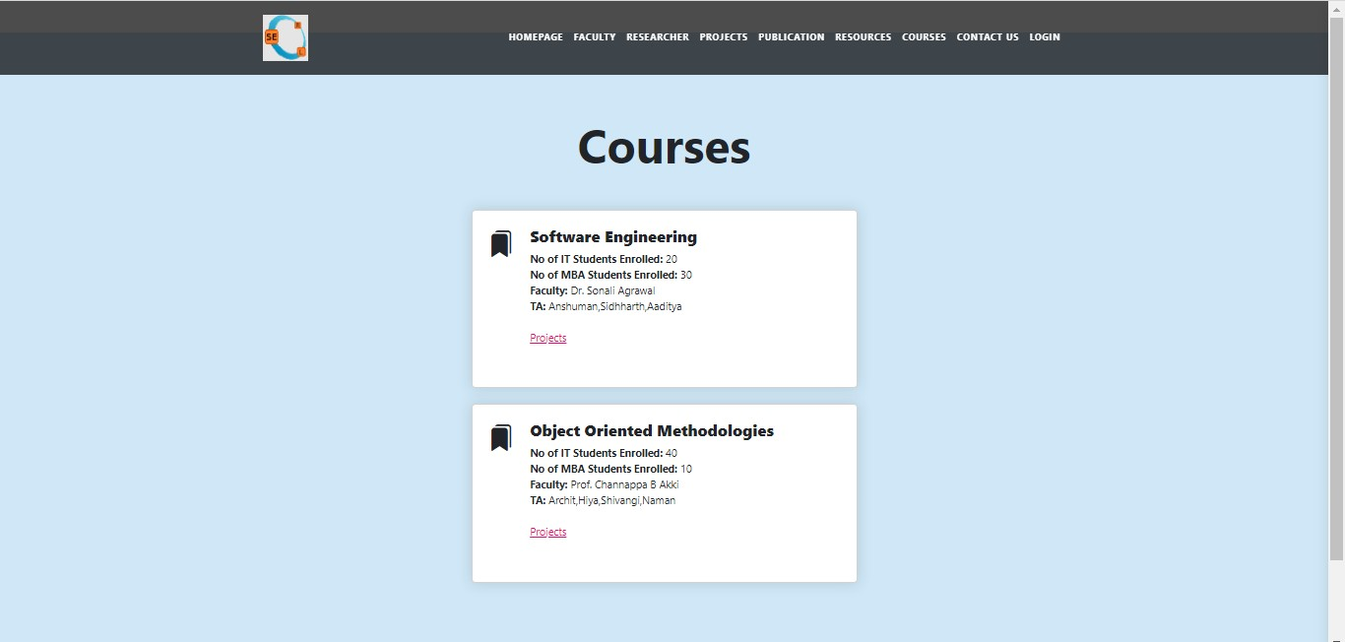

Slide 18
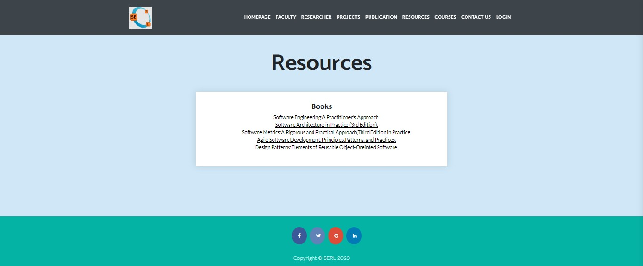

Slide 19
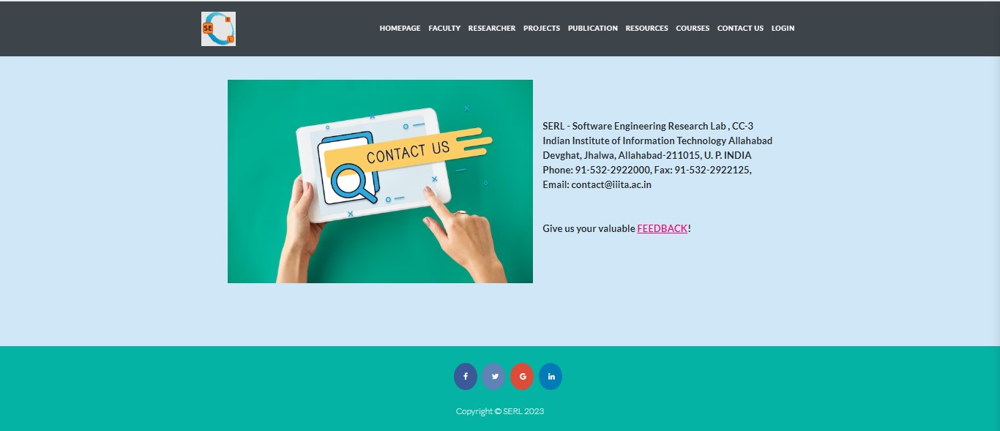

Slide 20
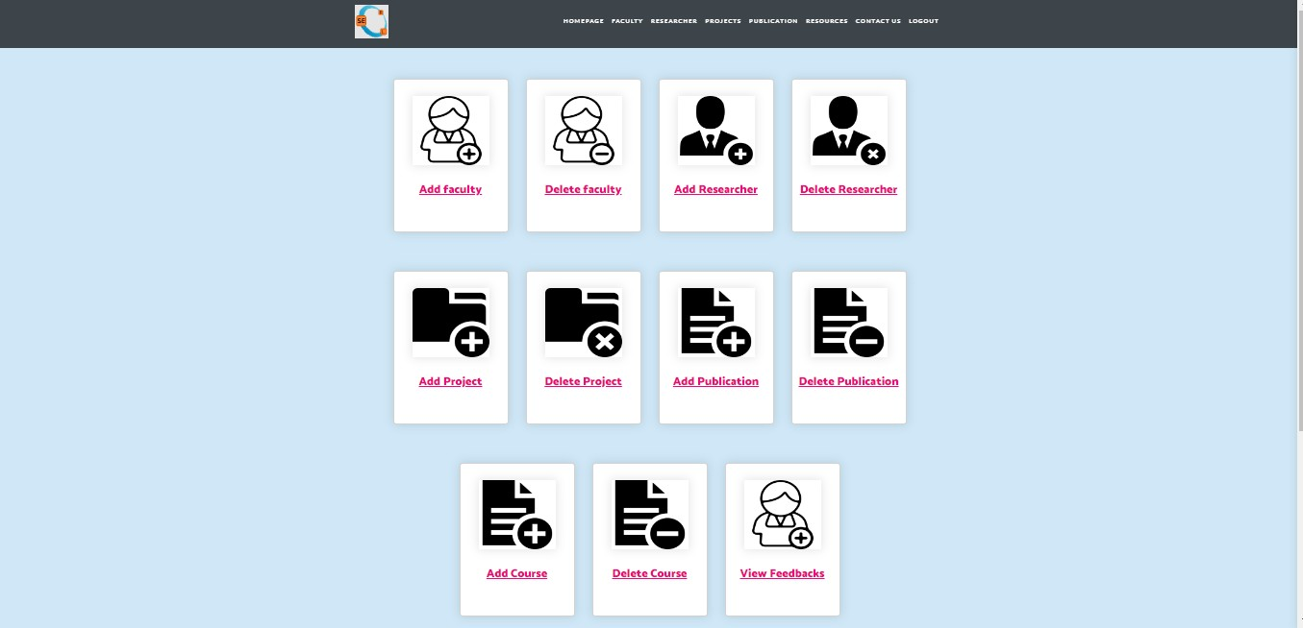

Slide 21
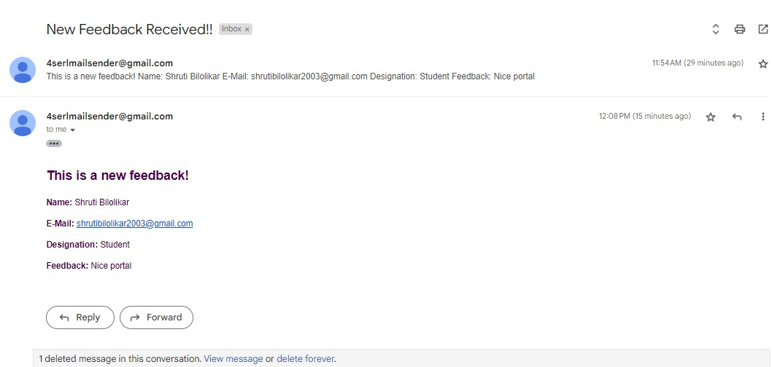

Slide 22

THANK YOU!

